Slide 1

Arterial Blood Gases (ABGs)
By Stuart Clarke
Highly Specialist Physiotherapist
Harefield Hospital

Slide 2
Learning Outcomes
To be able to recognise type 1 and type 2 respiratory failure
To be able to read and interpret arterial blood gases
To understand the physiology of acid-base balance and how the lungs and kidneys react to maintain homeostasis
To be able to recognise acute, chronic and acute on chronic respiratory failure

Slide 3
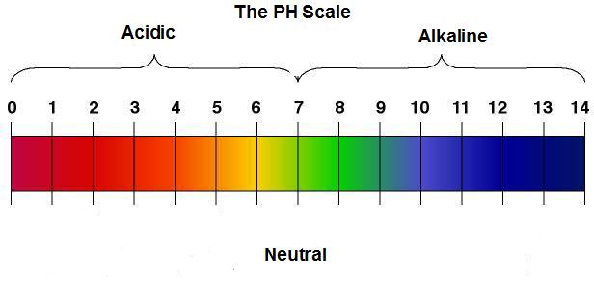
Acid-base Relationship
Acid-base balance refers to the degree of acidity or alkalinity in the body which is measured by the pH scale
Measure of H⁺ concentration
Normal pH: 7.35-7.45

Slide 4

Acid-base is controlled by the lungs, the kidneys and their associated buffer systems
Optimum cell function requires maintenance of well controlled H⁺ concentration – homeostasis
Normal metabolism results in the production of acids
An acid is a proton or hydrogen ion (H⁺) donor
A base is a proton or hydrogen ion acceptor

Slide 5

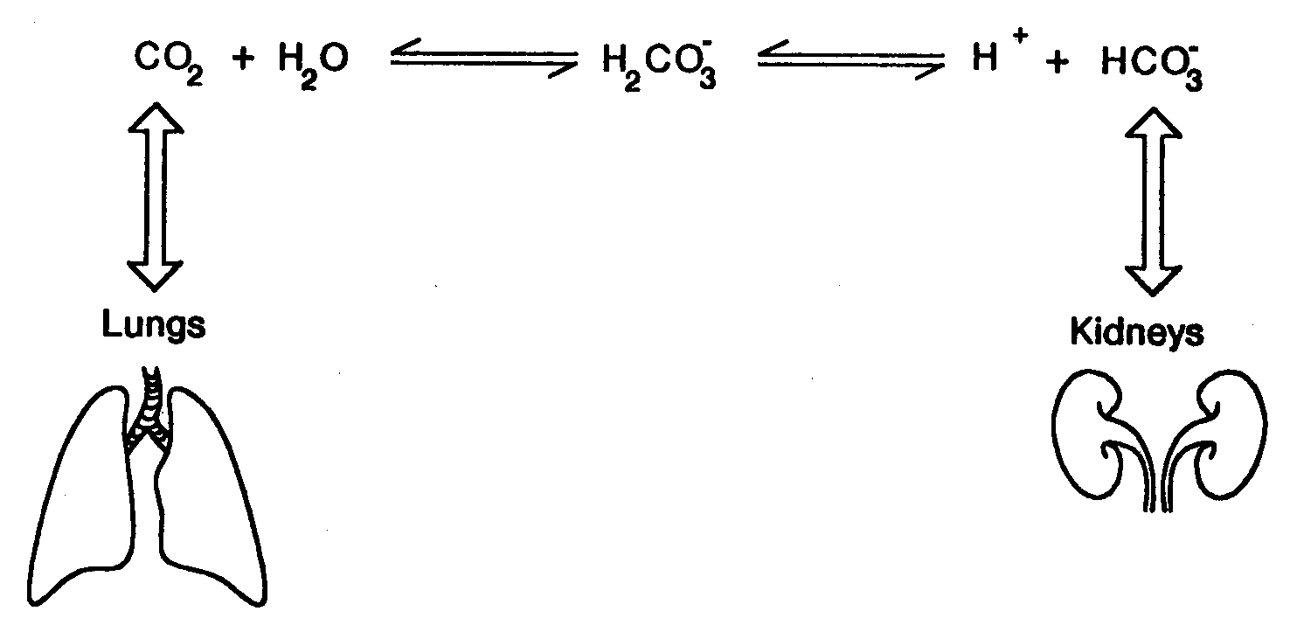
Acid-base Relationship
Bicarbonate buffer system
Involving the balance between carbonic acid, bicarbonate ion & carbon dioxide to maintain pH in the blood to support metabolic function
Failure of this buffer system to work correctly will alter the pH of the blood causing acidosis or alkalosis
What could effect this equation?

Slide 6

Normal Values
pH 7.35-7.45
Mean 7.4
pCO₂ 4.7-6kPa
pO₂ 11-14kPa
HCO₃⁻ 22-26mmol
Mean 25
BE -2 - +2

Slide 7
Interpretation
Step 1
Look at the pH
Is it acidic or is it alkaline?
pH > 7.45 = alkalotic
pH < 7.35 = acidotic

Slide 8

Interpretation
Step 2
Look at the pCO₂
A high pCO₂ will cause the pH to become more acidotic whereas a low pCO₂ will cause the pH to become more alkalotic
Is it within normal range?
If no, does the abnormality match that of the pH i.e. is the pCO₂ high and the pH low or is the pH high and the pCO₂ low? (Seesaw)
If this is the case then a primary respiratory problem has been identified
(4.7-6.0kPa)

Slide 9

Interpretation
Step 3
Look at HCO₃⁻
A high HCO₃⁻ will cause the pH to become more alkalotic whereas a low HCO₃⁻ will cause the pH to become more acidotic
Is it within normal range?
If no, does the abnormality match that of the pH i.e. is the HCO₃⁻ high and the pH High or is the pH low and the HCO₃⁻ low? (Elevator)
If this is the case then a primary Metabolic problem has been identified
(22-26mmol)

Slide 10

Interpretation
Compensation
Look at compensating variable
Is it within its normal range?
If yes, then it is uncompensated
If no, it has started to compensate
Refer back to the pH
Is it within normal range?
Yes – full compensation has occurred
No – partial compensation has occurred

Slide 11
Interpretation
Base excess
Acidotic: BE < -2
Normal: BE -2 to +2
Alkalotic: BE >+2

Slide 12
Examples
pH | 7.47
pCO₂ | 4.4
pO₂ | 8.0
HCO₃⁻ | 23
BE | +1

Slide 13

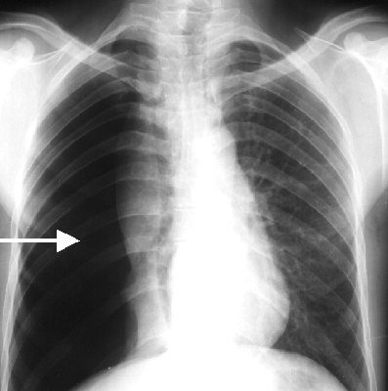
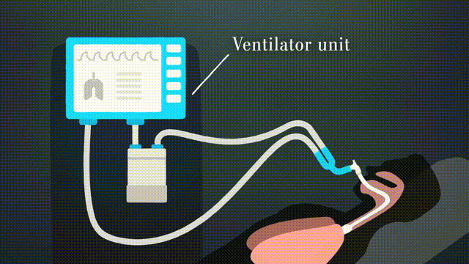


Examples
Excessive Artificial Ventilation
Pain
Hypoxia
  CNS disturbance
Fever/Sepsis/Shock

Slide 14
Examples
pH | 7.35
pCO₂ | 8.3
pO₂ | 10
HCO₃⁻ | 29.3
BE | +5

Slide 15


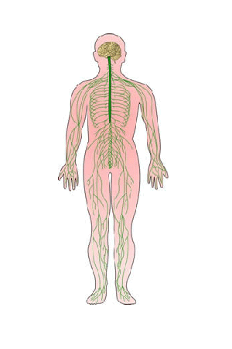


Examples
Respiratory Disease - COPD
Inadequate Artificial Ventilation
Neuromuscular Disease
Chest Wall Trauma
  CNS Depression/Excess Sedation
Pulmonary Oedema

Slide 16
Examples
pH | 7.2
pCO₂ | 4.1
pO₂ | 14.2
HCO₃⁻ | 19
BE | -5

Slide 17
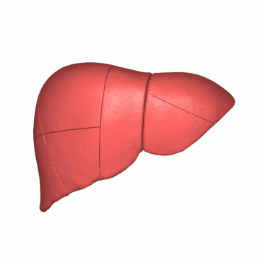


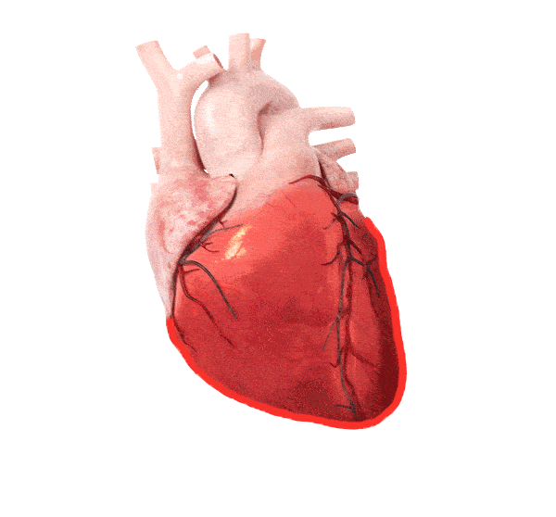
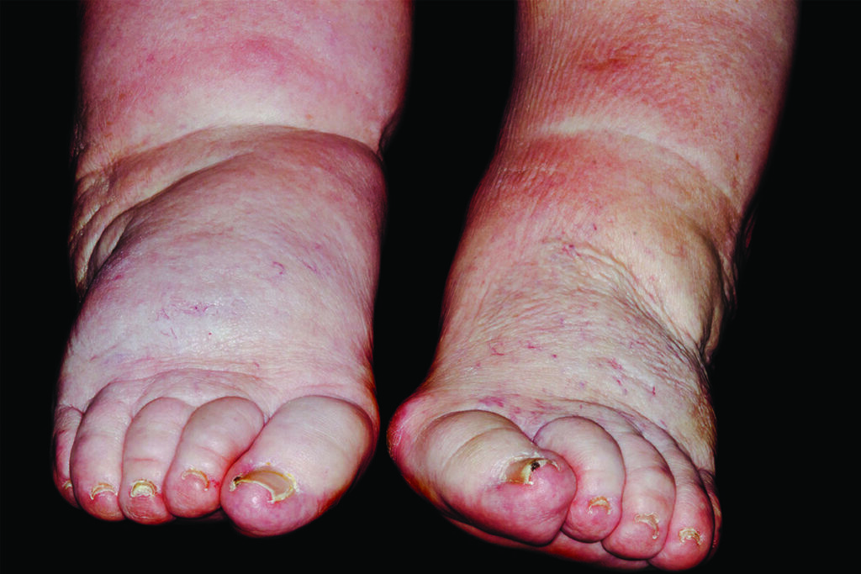
Examples
Prolonged Diuretic Therapy
Liver Cirrhosis
Excessive vomiting
  Heart Failure
Chronic Renal Failure
Hypervolaemia
Notes:
Reduced ability to excrete bicarbonate/Excessive loss of acid

Slide 18
Examples
pH | 7.49
pCO₂ | 6.9
pO₂ | 11
HCO₃⁻ | 28
BE | +4

Slide 19

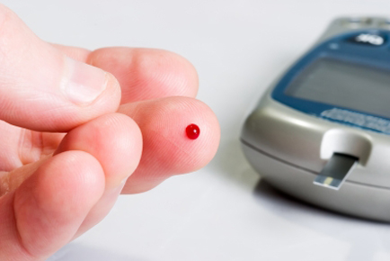

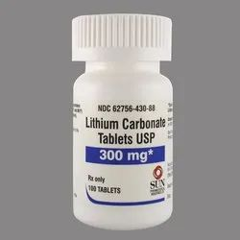
Examples
Diarrhoea
Lactic Acidosis
Ketoacidosis
  Medication Related
Acute Renal Failure

Slide 20
Respiratory Failure
The inability to maintain partial pressures in arterial blood of carbon dioxide (pCO₂) and oxygen (pO₂) within normal physiological limits
PaO₂ < 8kPa
PaCO₂ > 6.5 kPa

Slide 21

Type 1 Respiratory Failure
Decreased pO₂
Normal or low pCO₂
Treated with supplementary oxygen

Slide 22

Type 2 Respiratory Failure
Decreased pO₂
Increased pCO₂
Alveolar hypoventilation
Can be acute or chronic

Slide 23
Acute Type 2 Respiratory Failure
Decreased pO₂
Increased pCO₂
Normal HCO₃⁻
Kidneys take 2-3 days to compensate
Decreased pH – uncompensated respiratory acidosis

Slide 24
Chronic Type 2 Respiratory Failure
Decreased pO₂
Increased pCO₂
Increased HCO₃⁻
Kidneys have had time to compensate
Normal pH – fully compensated respiratory acidosis

Slide 25
Acute on Chronic Type 2 Respiratory Failure
Decreased pO₂
Increased pCO₂
Increased HCO₃⁻
pH high
pCO₂ normally high but due to sudden deterioration has risen further so kidneys no longer able to compensate

Slide 26
Examples
pH | 7.33
pCO₂ | 7.4
pO₂ | 6.2
HCO₃⁻ | 23
BE | +1
pH | 7.36
pCO₂ | 6.7
pO₂ | 7.9
HCO₃⁻ | 33
BE | +7
pH | 7.32
pCO₂ | 7.8
pO₂ | 7.3
HCO₃⁻ | 33
BE | +7

